Slide 1
Camera Motion Detection and Alarm System
Prepared by:
Amal Irshaid
Fayyad Salahat
Shatha Abu AlRob
Supervisor: Prof. Dr. Adwan Yasin

Slide 2
CHAPTER 1: INTRODUCTION
Background and Motivation
Aims and Objectives
Problem Statement
Contributions

Slide 3
Indicator | Years
 | 1996 | 1999 | 2004 | 2008 | 2012 | 2016
Percentage of persons exposed to theft\robbery attempt | 54.2 | 55.2 | 19.5 | 33.9 | 41.9 | 61.8
Percentage of persons exposed to threat\ assault | 18.8 | 18.0 | 13.1 | 18.4 | 10.6 | 14.9
Percentage of persons exposed to property damage | 16.1 | 4.4 | 8.2 | 18.3 | 3.0 | 0.4
Physical Harm and Tangible Losses of Last Crime*
Percentage of persons exposed to criminal offense and caused physical harm | 22.6 | 16.5 | 10.5 | 12.3 | 5.5 | 8.6
Table 1.1 Main Indicators of Victimization Survey 1996-2016:

Slide 4
Aims and Objectives
Delve deeper into the principles of data and information security.
Learn how to develop motion detection algorithm (OpenCV) inside our security system using Raspberry pi and pi cam to detect human motion.
Increase our knowledge while using Ubuntu 18.04.4 LTS (Linux distribution).

Slide 5
Obtain more experience about how to build a mobile application using Java programming language by Android Studio.
Examine (trying to use) firebase to use it as a replacement for SQL database.

Slide 6
Problem Statement & Contributions.

Slide 7
CHAPTER 2: LITRITURE REVIEW.
Overview
Existing Systems
Home surveillance and motion detection
Room Guard
Comparesion

Slide 8
Home surveillance and motion detection

Slide 9
The hardware used in the project are:
Raspberry pi
Pi camera
To access Raspberry pi video stream, should installed OpenCV on Raspberry pi.
OpenCV is a library of programming functions mainly aimed at real-time computer vision, in simple language it is library used for Image Processing. It is mainly used to do all the operation related to Images.

Slide 10
Room Guard

Slide 11
This system detect motion using PIR sensor, camera model and buzzer with Raspberry pi, when pir sensor detect motion the camera start to captor photo for the motion and the buzzer start get alarming, then send notification for user phone.
The hardware used:
Raspberry pi
Camera model
PIR sensor
Buzzer
The programming language used is python.

Slide 12
 | Home Surveillance and Motion Detection | Room Guard | Motion Detection System with Alarm System
Use Sensor | No | Yes | No
Connected to an application | No | Yes | Yes
Programming Language | Python | Python | Python
Accuracy | Medium | Strong | Medium
Alarm | None | Buzzer + Send Notification on the Mobile App | Send Notification on the Mobile App
System Component | Raspberry pi Pi Camera | Raspberry pi Camera model PIR sensor Buzzer Android App | Raspberry pi Camera model Android App

Slide 13
CHAPTER 3: System Design and Solution
Introduction
Hardware
Hardware Components
Hardware Description
Algorithm Description
Software Description

Slide 14
Hardware Components
Raspberry pi 3 module B+
The pi camera module 2

Slide 15
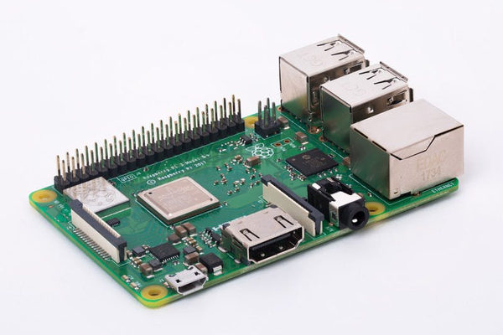
Raspberry pi 3 module B+
Broadcom BCM2837B0, Cortex-A53 (ARMv8) 64-bit SoC @ 1.4GHz
1GB LPDDR2 SDRAM
2.4GHz and 5GHz IEEE 802.11.b/g/n/ac wireless LAN, Bluetooth 4.2, BLE
Gigabit Ethernet over USB 2.0 (maximum throughput 300 Mbps)
Extended 40-pin GPIO header
Full-size HDMI
4 USB 2.0 ports
Raspberry Pi standard 40 pin GPIO header (fully backward compatible with previous boards).
2 × micro-HDMI ports (up to 4kp60 supported).
2-lane MIPI DSI display port.
2-lane MIPI CSI camera port.
4-pole stereo audio and composite video port.
H.265 (4kp60 decode), H264 (1080p60 decode, 1080p30 encode).
OpenGL ES 3.0 graphics.
Micro-SD card slot for loading operating system and data storage
5V DC via USB-C connector (minimum 3A*).
5V DC via GPIO header (minimum 3A*).
Power over Ethernet (PoE) enabled (requires separate PoE HAT).
Operating temperature: 0 – 50 degrees C ambient.

Slide 16
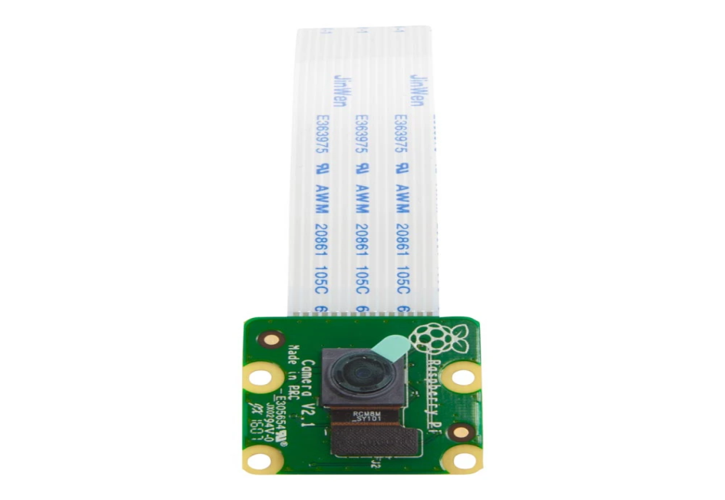
The pi camera module 2
The Features:
Fully Compatible with Both the Model A and Model B Raspberry Pi
5MP Omni vision 5647 Camera Module
Raspberry Pi Camera, supports all revisions of the Pi
Using IR-CUT filter, it can eliminate color distortion in the daylight
Comes with infrared LED, supports night vision
Can Attach IR LEDs if Night Vision mode is required
15-pin MIPI Camera Serial Interface - Plugs Directly into the Raspberry Pi Board
Still picture resolution: 2592 x 1944
Max video resolution: 1080p
Camera Size: 20 x 25 x 9mm
Camera Weight 3g
Fully Compatible with many Raspberry Pi cases

Slide 17
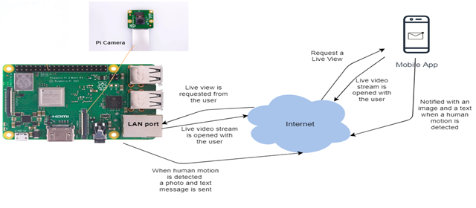
Architectural Diagram

Slide 18
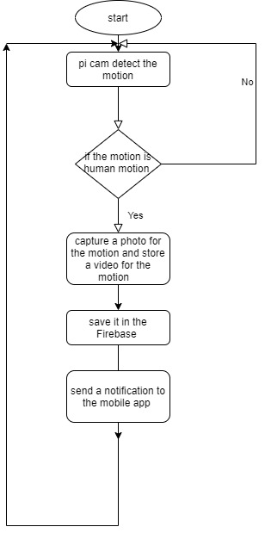
Main System Algorithm Design

Slide 19
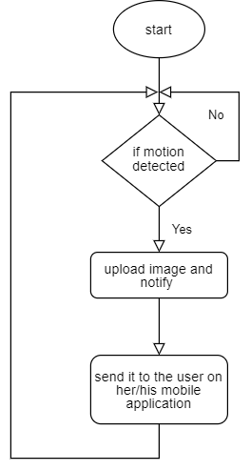
Send Notification Algorithm

Slide 20
Hardware Description

Slide 21
First, we downloaded the Raspbian OS on the Raspberry pi 3 module B+ because it is a 32-bit system, so that’s the most suitable Linux system.
Next, all libraries needed in python were imported to the new OS so that they can be used later to build our motion detection system application. Plus the libraries needed to connect and be able to take pictures using Pi Camera.
Then, establish the connection with the Pi Camera.
Finally, create our motion detection system using python which will be presented at the end of this presentation.

Slide 22
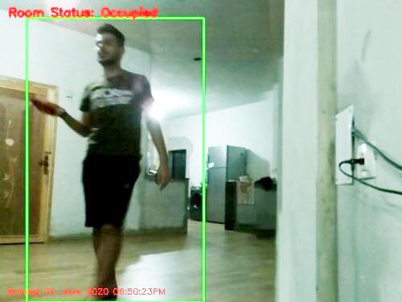
Result #1

Slide 23
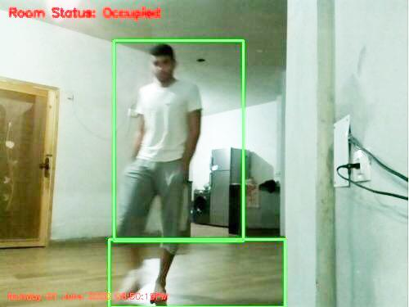
Result #2

Slide 24
Algorithm Description

Slide 25
Preparing:
Install a python compiler on Ubuntu to be able to run the python code written using any text application.
Install all needed packages to run this algorithm. Basically, OpenCV.
Reading the video file either as .mp4 file or as a live video stream on webcam using the web browser.
Cutting the video into several frames to be image processed separately. The first frame will contain no motion so that’s how the background will be noticed and distinguished.
Loop over the video frames. If frame can’t be found then it’s the end of the video.
Ready to perform motion detection:
Compute the absolute difference between the basic frame and the current frame.
Dilate the threshold image to fill in holes, then find contours on threshold image. Then loop over these contours.
If the contour is too small, ignore it. Compute the bounding box (Green Box) for the contour, draw it on the frame, and update the text (Occupied or Not Occupied).

Slide 26
Software Description

Slide 27
Unleashing the power of Google Analytics
Crash reporting to fix Bugs
Monitoring errors: It is capable of monitoring fatal errors for iOS apps and both fatal and non-fatal errors for Android apps. Generally, reports are initiated as per the impact caused by such errors on the user experience.
Required data collection to fix errors: The reports also enlist all the details concerning the device in use, performance shortfalls, and user scenarios concerning the erroneous events. According to the contributing factors and other similarities, the issues are grouped in different categories.
Email alerts: It also allows sending email alerts as and when such issues or problems are detected.
The configuration of error reporting: The error reporting can also be configured remotely to control who can access the reports and list of events that occurred before an event.
It is free: Crash and bug reporting is free with Firebase. You don’t need to pay a penny to access this feature.

Slide 28
Synchronizing data with real-time database
Real-time: Unlike the so-called HTTP requests that work to update the data across interfaces, the Real-time Database of firebase syncs data with every change thus helping to reflect the change in real-time across any device in use.
Offline: As Firebase Real-time Database SDK helps save your data in local disk, you can always access the data offline. As and when connectivity is back, the changes are synced with the present state of the server.
Access from multiple devices: The Firebase Real-time Database allows accessing application data from multiple devices and interfaces including mobile devices and web.
Splitting and scaling your data: Thanks to Firebase Real-time Database, you can split your data across multiple databases within the same project and set rules for each database instance.

Slide 29
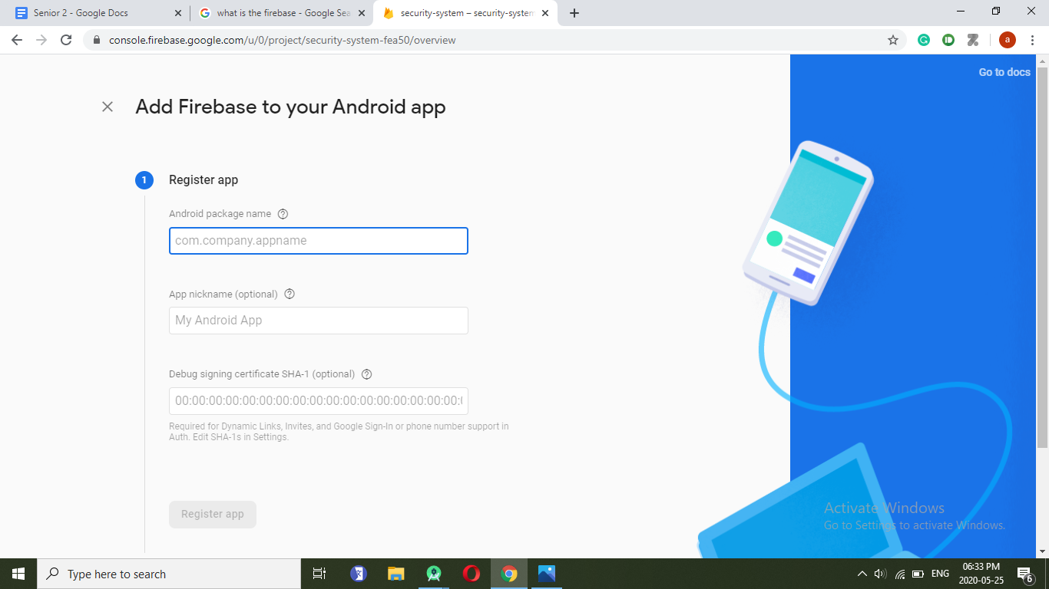

Slide 30
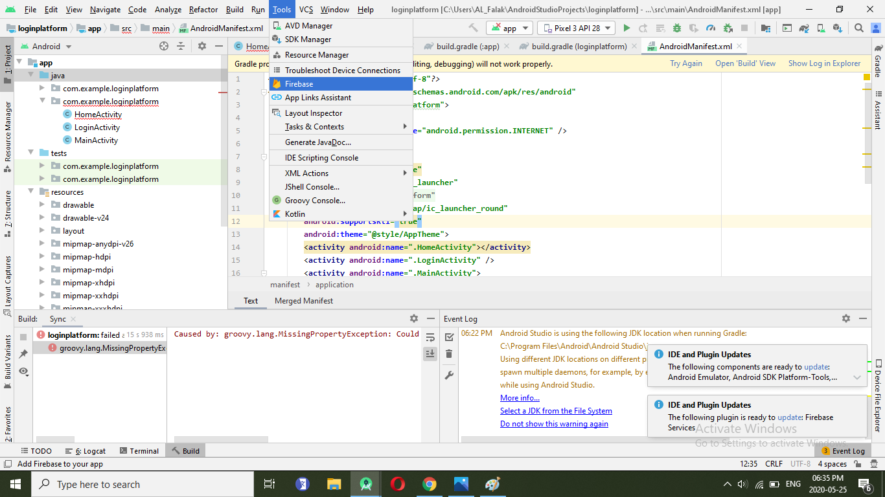

Slide 31
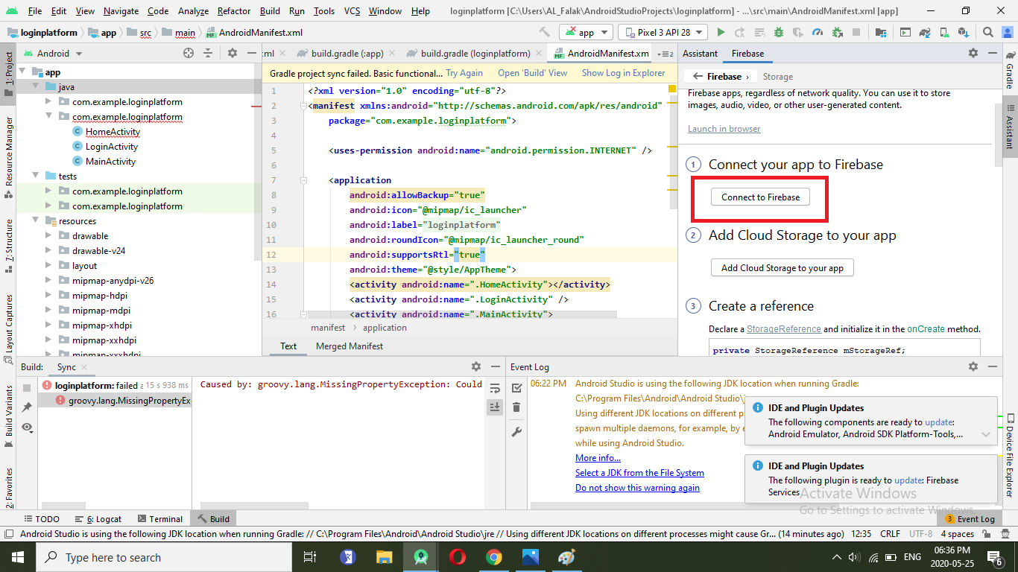

Slide 32
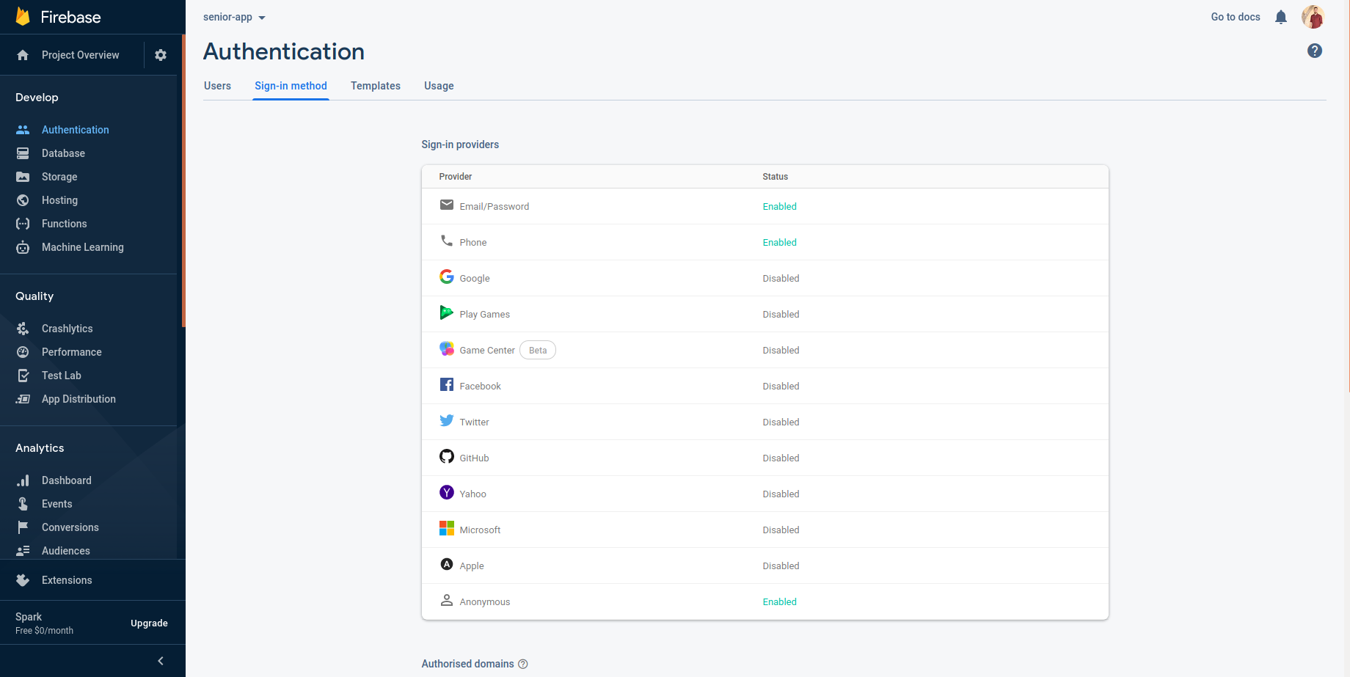

Slide 33
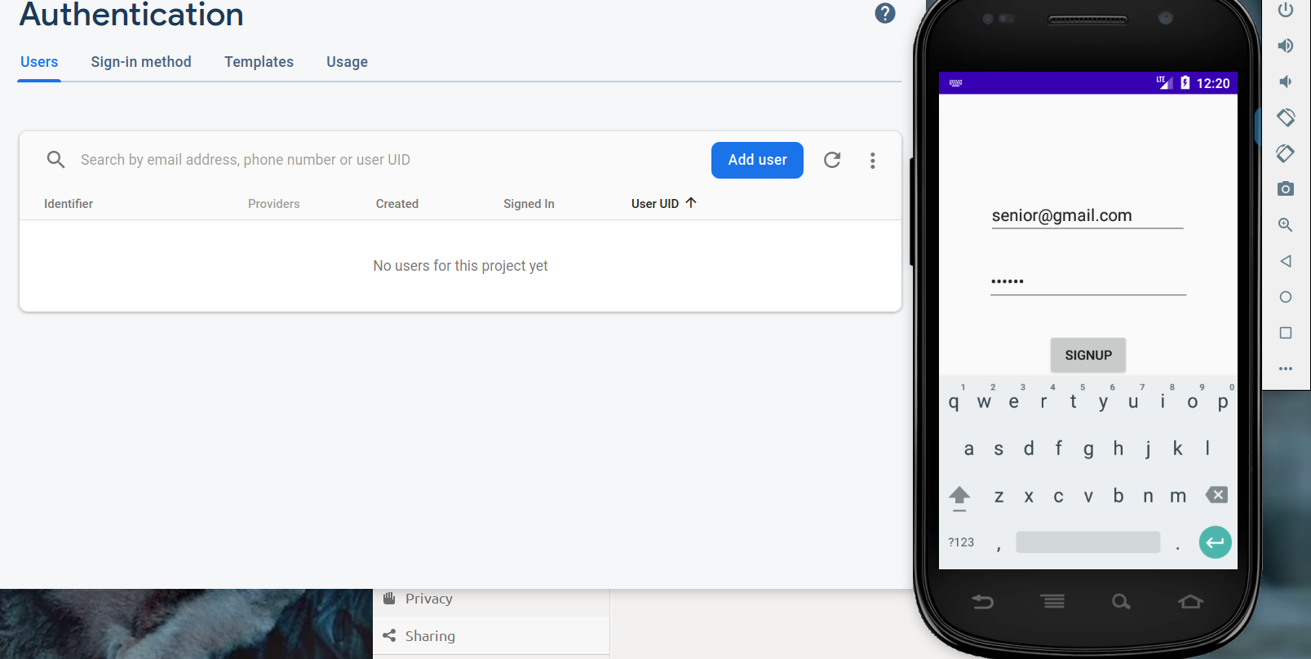

Slide 34
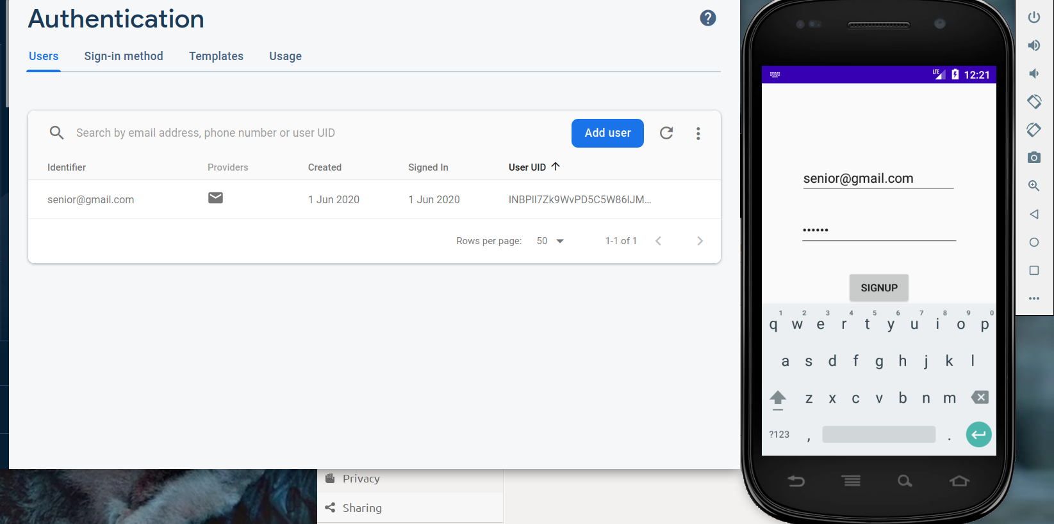

Slide 35
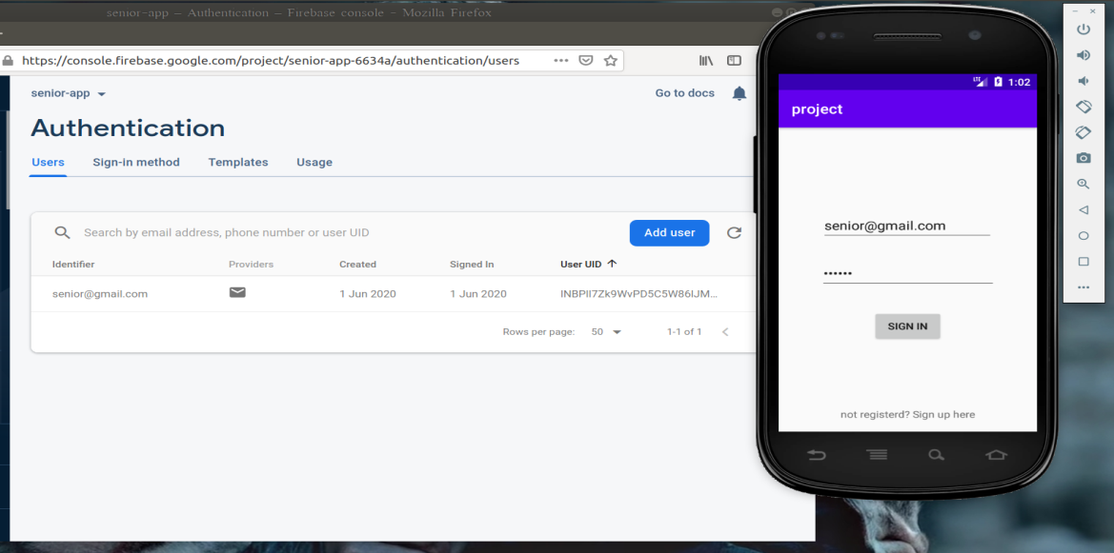

Slide 36
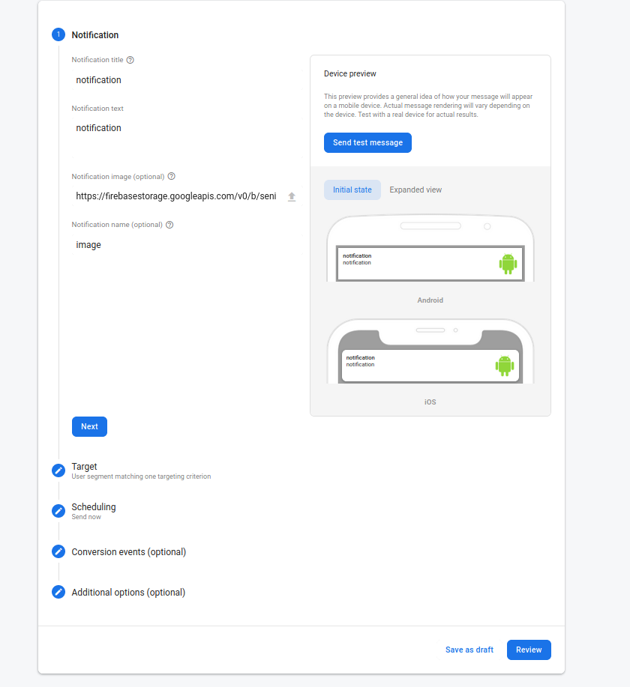

Slide 37
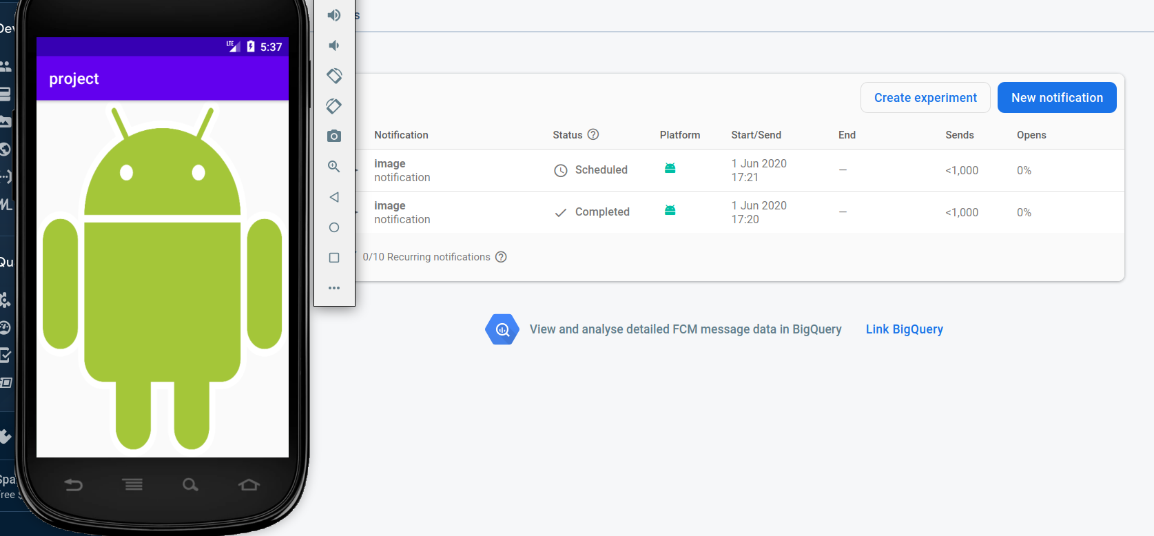

Slide 38
Future Work
Add a new features such as:
Open live video stream, this gives the user of the android application, the ability to watch a what’s happening in front of the camera in real-time
Connect the system to a Firebase rather than Dropbox.

